Slide 1
Python vs Other Programming Languages

Slide 2
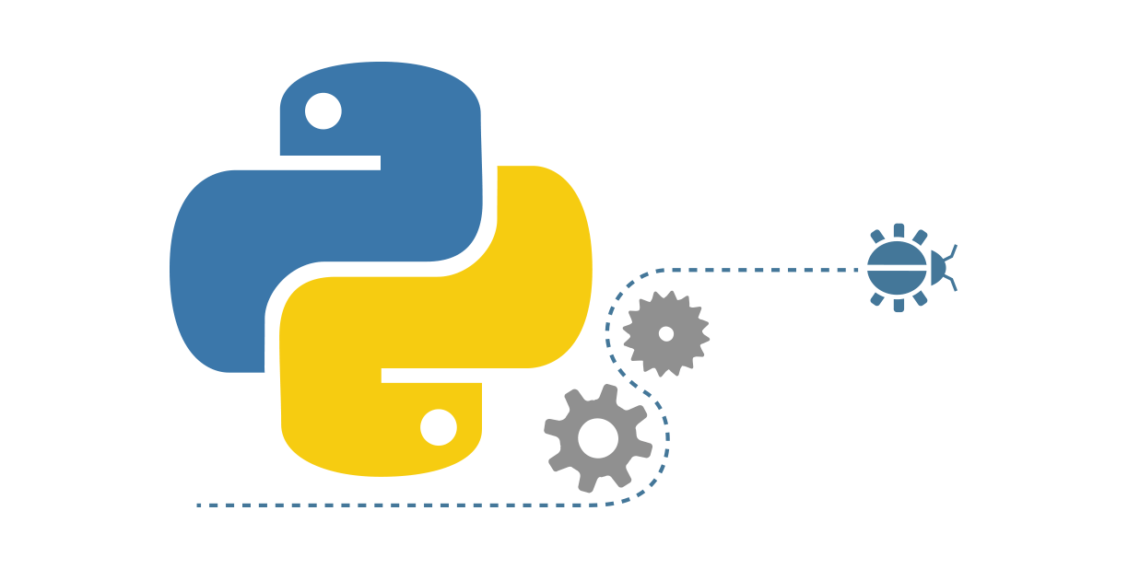
Agenda
Objective
Python vs Other Programming Languages
Benefits of Python over Other Programming Languages.
Notes:
To understand this, let’s take a scenario.

Slide 3
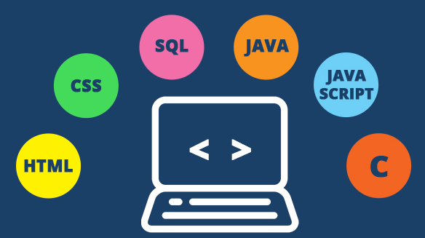
Choosing a Programming Language
In practice, the choice of a programming language is often dictated by other real-world constraints such as cost, availability, training, and prior investment, or even ease of execution.
Different scenarios and use-cases call for different programming languages.

Slide 4
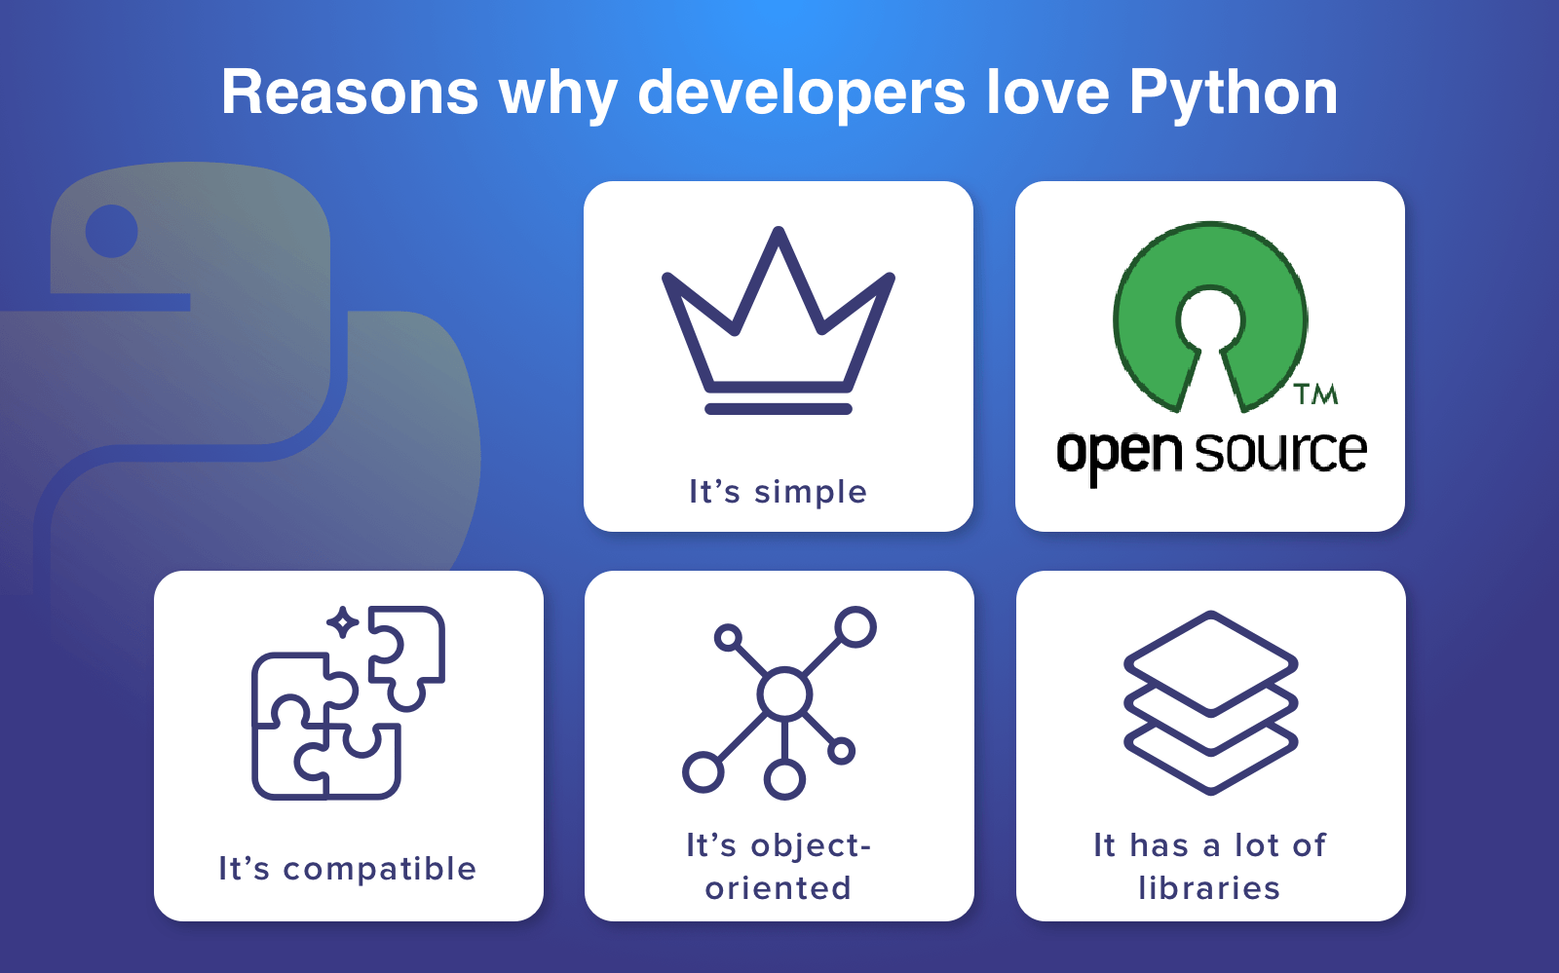
Notes:
Simplicity
We can say that Python is a minimalistic language. It is very easy to write and read. And when it is time to think about a problem, a developer can focus on the issue, not on the language and its syntax.
It's free
Python is free and open source. It means that the developers don't have to pay for anything. They can share, copy and change it. This fact has also helped Python to create a very strong community around itself which only makes it stronger and develops the technology very fast. The community allows professionals to share their knowledge and experience with beginners.
Compatibility
Python is compatible with numerous platforms, so a developer doesn't have to bother about any issues which often occurs with other languages.
Object-oriented
Python supports procedure-oriented as well as object-oriented programming. In the procedure-oriented programming, a developer applies reusable pieces of code. The object-oriented programming uses objects which are based on data and functionality. Despite the fact that OOP languages are usually very complex, Python managed to stay simple and neat.
LIbraries
Python community has created a huge pile of various libraries for Python. With their help, you can manage documentation, perform unit testing, databases, web browsers, email, cryptography, graphical user interface and many more things. All there stuff is included in the standard library, however, except it, there are a lot of other libraries available.

Slide 5
Python vs Other Programming Languages

Slide 6
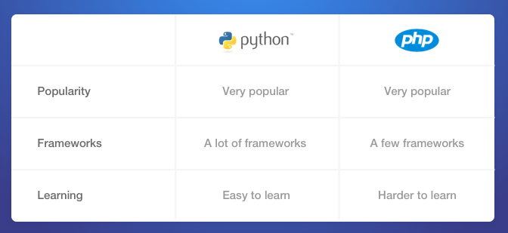
Python vs PHP
Notes:
To understand this, let’s take a scenario.

Slide 7
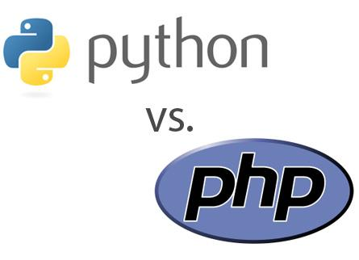
Python vs PHP
Python’s syntax is easier and simple to learn. Unfortunately, we can't say the same about PHP.
PHP requires much more time and efforts to master. Python lets you make minor mistakes without code breakages.
But don't forget that PHP was created specifically for web development and is used here more often.
Notes:
To understand this, let’s take a scenario.

Slide 8
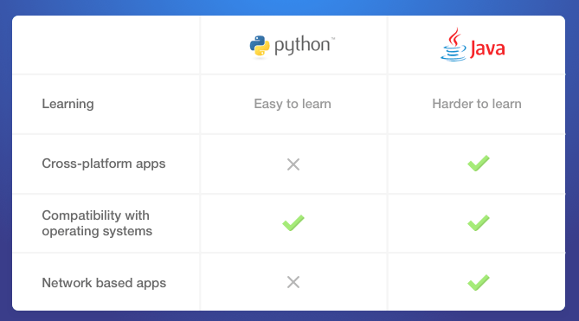
Python vs Java
Notes:
To understand this, let’s take a scenario.

Slide 9
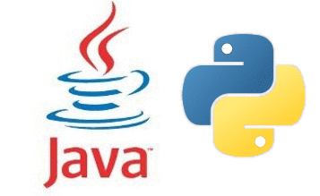
Python vs Java
Java allows you to create cross-platform apps, while Python is compatible with almost all modern operating systems.
The other advantage of Java is that it lets you create network-based apps while Python can't boast of it.
Notes:
To understand this, let’s take a scenario.

Slide 10
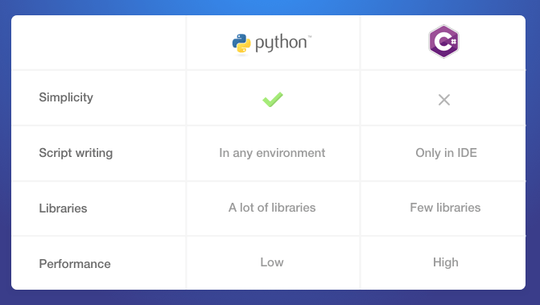
Python vs C#
Notes:
To understand this, let’s take a scenario.

Slide 11
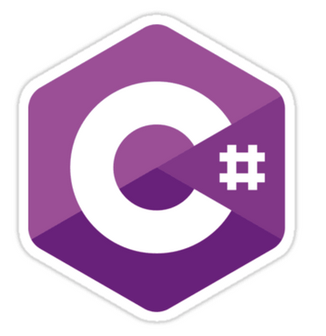

Python vs C#
The technologies are very different but both can be used for web development.
There is no correct answer what language Python or C# is better.
Python is easier to learn, it has many more open source libraries compared to C#. Yet, the standard library of C# is better than Python's, C# has more features, its performance is higher and it evolves really fast.
Notes:
To understand this, let’s take a scenario.

Slide 12
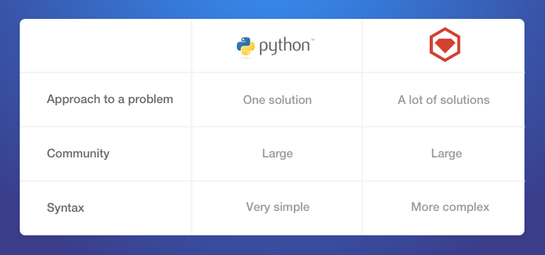
Python vs Ruby
Notes:
To understand this, let’s take a scenario.

Slide 13
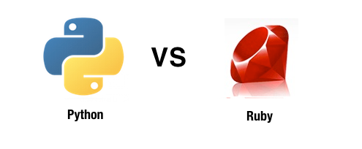
Python vs Ruby
Ruby and Python are both object-oriented languages, and both are dynamic and flexible.
The main difference between these technologies lies in a way they solve a problem.
Ruby offers different approaches while Python usually has only one. This fact can become an advantage and a disadvantage at the same time.
Notes:
To understand this, let’s take a scenario.

Slide 14
Bottomline
Similarly, there are many other situations where a particular programming language may be preferred. For example:
When we need concurrency, we choose GO/Erlang over Python
When using for hardware related development, C is preferred
To develop applications which can run on any platform, Java is the go to language.

Slide 15
Python vs Other Programming Languages

Slide 16
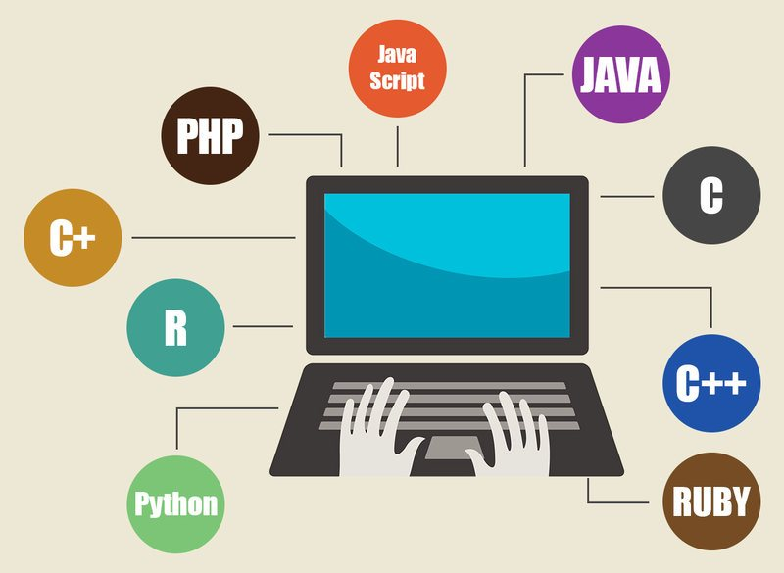
Benefits of Python over other Programming Languages
The diverse application of the Python language is a result of the combination of features which give this language an edge over others. Some of the benefits of programming in Python include:
Presence of Third Party Modules
Extensive Support Libraries
Open Source and Community Development
Learning Ease and Support Available
User-friendly Data Structures
Productivity and Speed

Slide 17
END

